Slide 1

Stock Price Prediction using LSTM with Attention
Presented By
Student Name: Nagaraju Poralla
College Name: Siddhartha Institute of Engineering and technology
Department:CSE(Ai&Ml)
Email ID:NAGARAJUPORALLA13@GMAIL.COM
AICTE Student ID: STU662630beb93f41713778878(AINSI_99224)

Slide 2
OUTLINE
Problem Statement (Should not include solution)
Proposed System/Solution
System Development Approach (Technology Used)
Algorithm & Deployment
Result (Output Image)
Conclusion
Future Scope
References

Slide 3
Problem Statement
Predicting stock market trends is inherently complex due to its non-linear and volatile nature.
Traditional statistical models often fail to capture long-term dependencies.
Need for an intelligent model that can focus on relevant time steps for accurate predictions.

Slide 4
Proposed Solution
Use Long Short-Term Memory (LSTM) networks to capture sequential patterns.
Integrate a custom Attention Mechanism to prioritize significant time steps.
Train on historical stock data to predict future closing prices.

Slide 5
System Approach
Data Collection: Using Yahoo Finance API (yfinance)
Python
TensorFlow/Keras
Preprocessing:
Normalization using MinMaxScaler
Sequence slicing (e.g., 60 previous days → 1 prediction)
Model Building:
LSTM layers
Custom Attention layer
Dense output layer

Slide 6
Algorithm & Deployment
Algorithm Workflow:
Input historical price sequences
Pass through LSTM layers
Apply Attention mechanism
Predict next-day price using dense layers
Deployment Ideas:
Flask or Streamlit web app for real-time predictions
Hosted on platforms like Heroku or AWS EC2

Slide 7
Result
Model shows improved accuracy compared to baseline LSTM
Attention layer helps the model focus on important inputs
Visual graphs indicate strong correlation between actual and predicted values

Slide 8
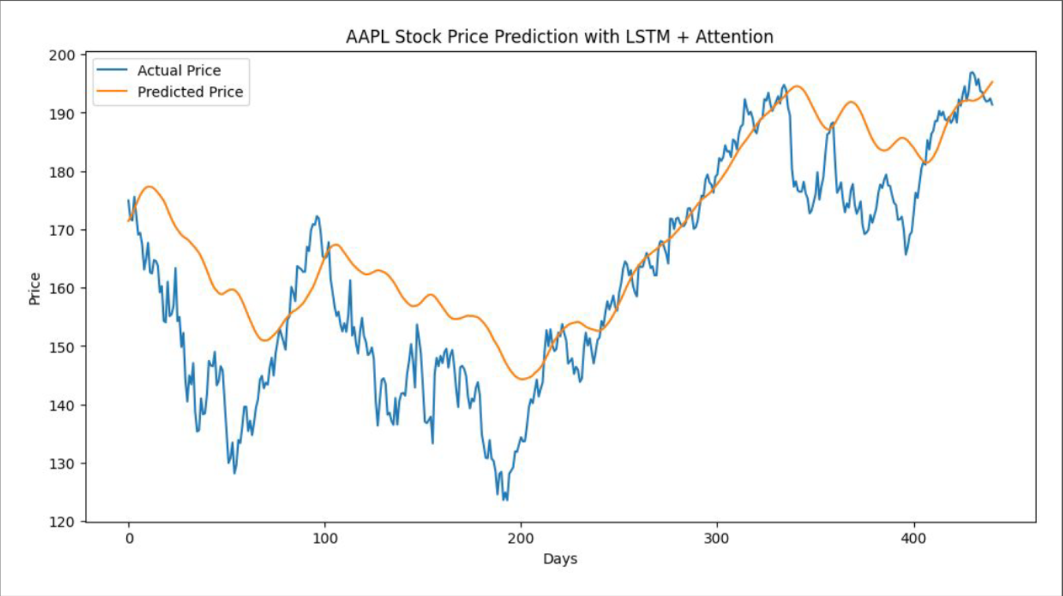
Result (OutPut image)

Slide 9
Conclusion
LSTM with Attention offers a robust solution for stock price prediction
Attention increases interpretability and model efficiency
The hybrid architecture is promising for financial forecasting

Slide 10
Future scope
Add features like:
Trading volume
Opening price
Technical indicators
Experiment with:
Bidirectional LSTM
Transformer models
Create an end-user application with real-time data feeds

Slide 11
References
TensorFlow/Keras documentation
Scholarly articles on LSTM and Attention mechanisms
Github Link : https://github.com/Porallanagaraju13/
Data Set :https://finance.yahoo.com/

Slide 12
Thank you

